Slide 1
Gps Tracker Dataset
Normal vs Attacks Classification

Slide 2
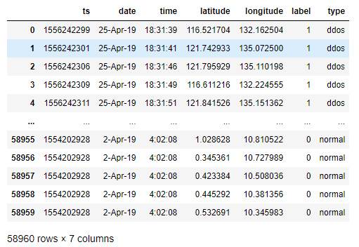
About the dataset

Slide 3
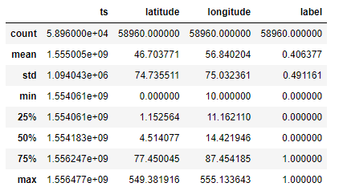
Dataset numeric values description

Slide 4
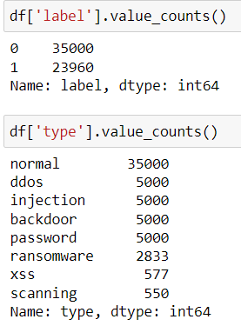
Messages and attacks count

Slide 5
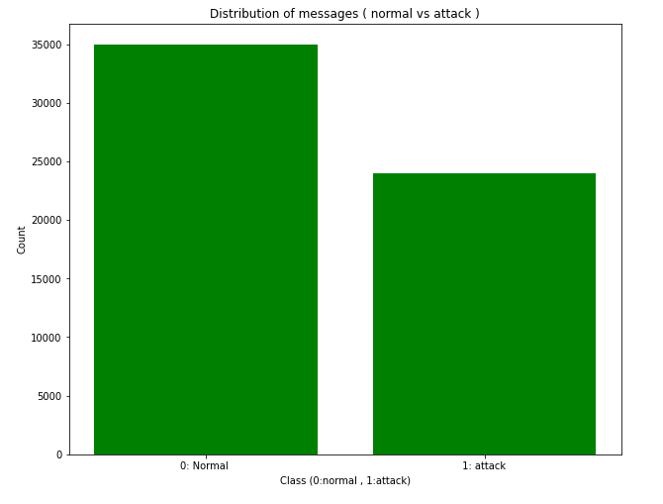
Normal vs Attack distribution

Slide 6
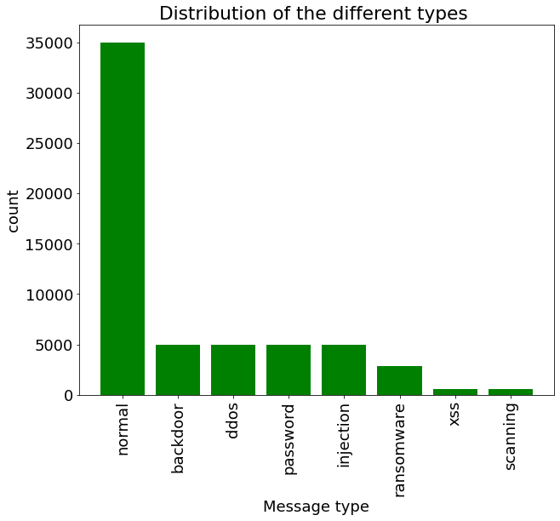
Normal and Attacks distribution

Slide 7
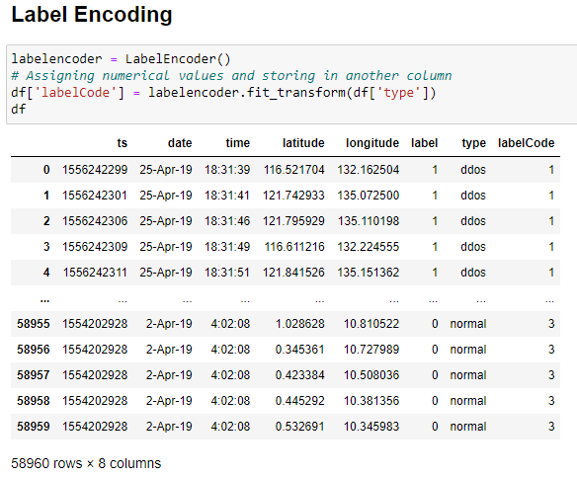
Label encoding the target variable (type)

Slide 8
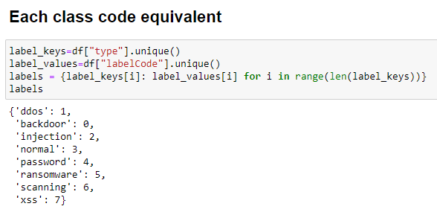
Each class code equivalent

Slide 9
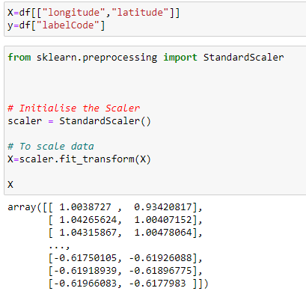
Feature selection + scaling

Slide 10
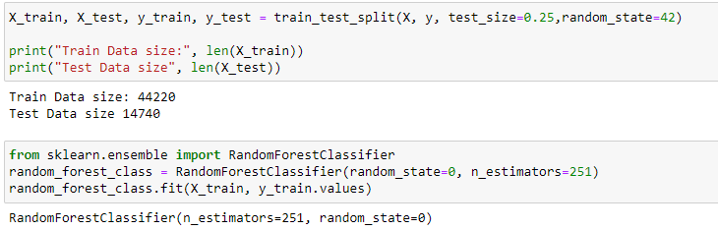
Data splitting and model training ( Random Forrest)

Slide 11
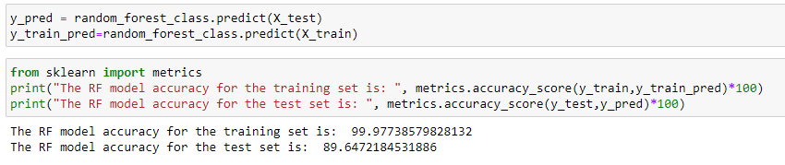
Prediction and accuracy metric

Slide 12
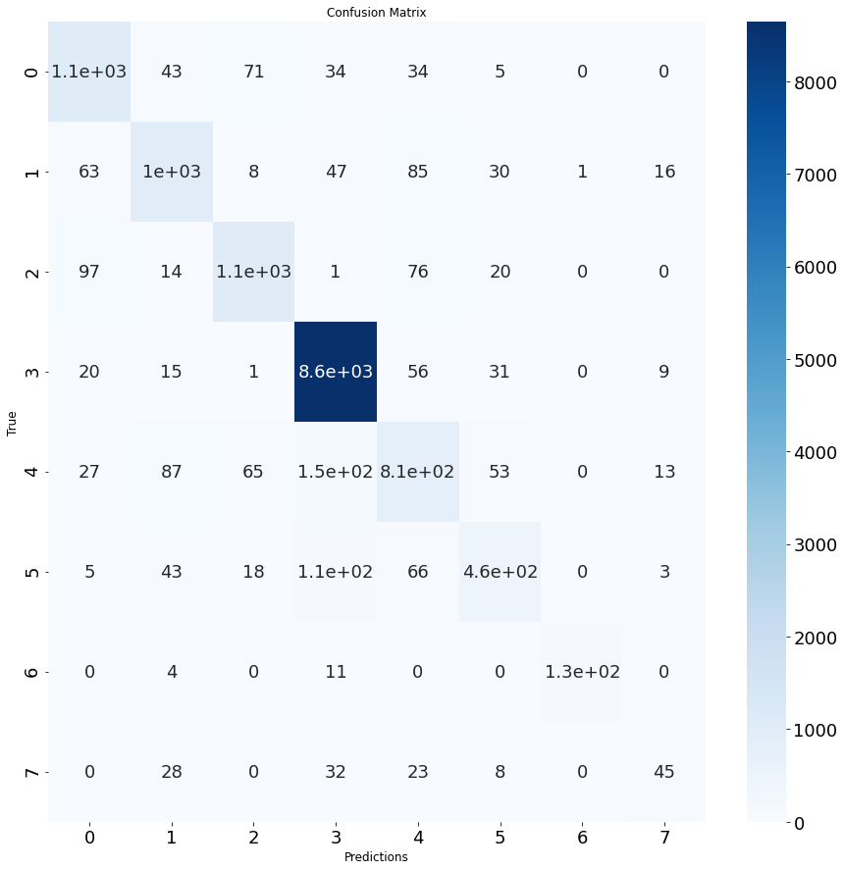
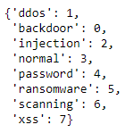
Confusion matrix

Slide 13
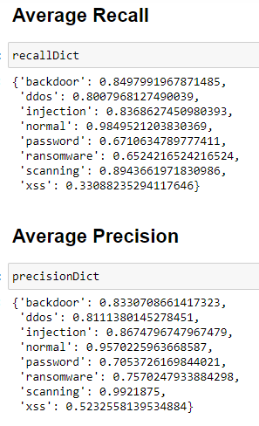
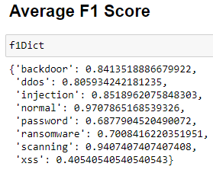
Recall, Precision, F1 score

Slide 14
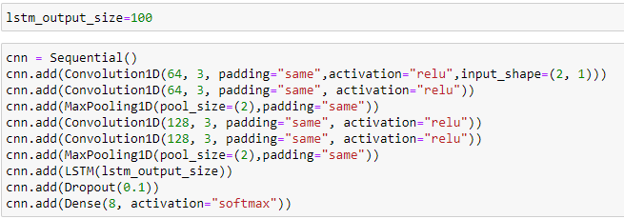
1D CNN LSTM model

Slide 15
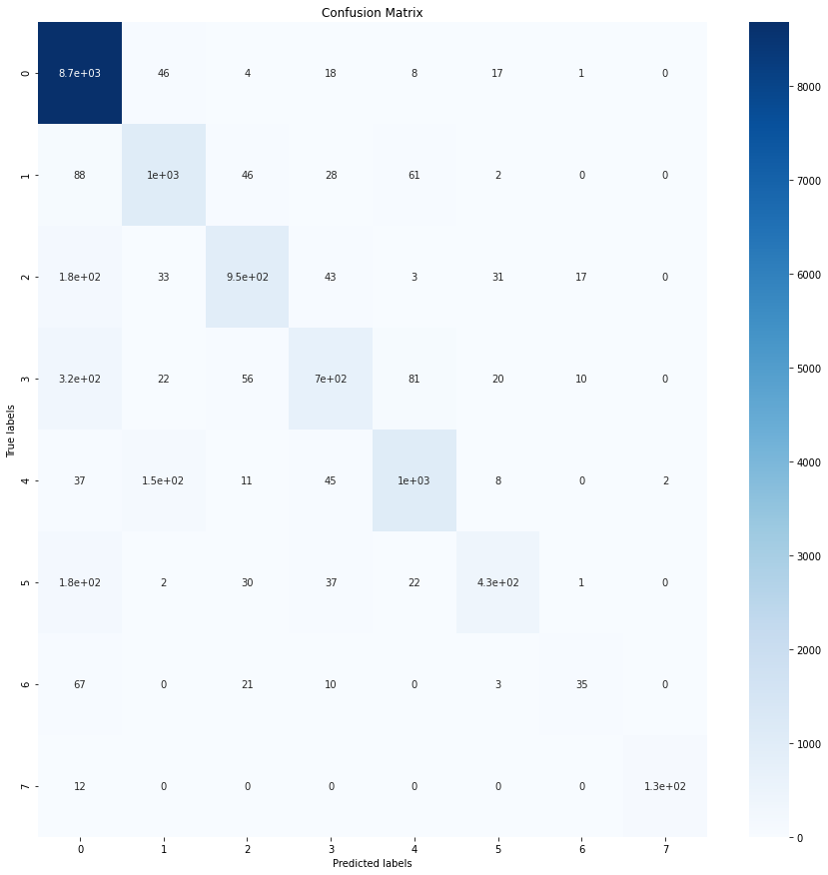
Train and Test accuracy + Confusion Matrix
Train accuracy: 90,45% < 99,97% Test accuracy: 89,10% < 89,64%

Slide 16
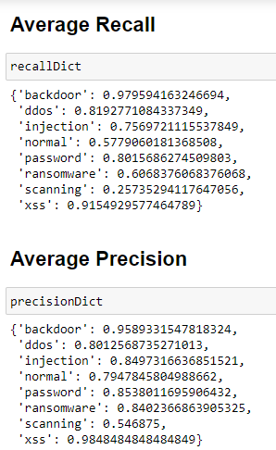
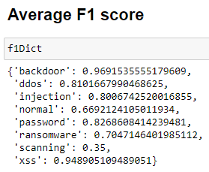
Recall, Precision, F1 score

Slide 17
Conclusion
The RF forrest is a bit better than the 1D CNN LSTM model in accuracy term
But the RF model has a much better Recall, Accuracy and F1 score concerning the normal class which is important as we do not want the normal type of messages mistaken as attack
Model / metric | Recall | Precision | F1 score
Random Forrest model | 0,98 | 0,96 | 0,97
1D CNN LSTM model | 0,58 | 0,79 | 0,67
The normal class metrics for each model

Slide 18
Decision Tree + Naive Bayes
 | Train accuracy | Test accuracy
Decision Tree | 99,97 % | 86,86 %
Naive Bayes | 60% | 60,35%

Slide 19
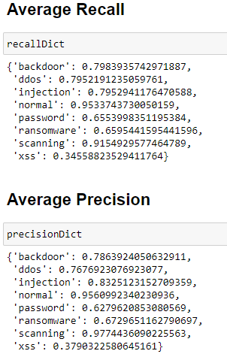
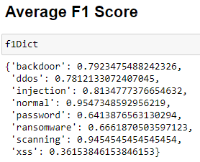
Recall, Precision, F1 score (Decision Tree)

Slide 20
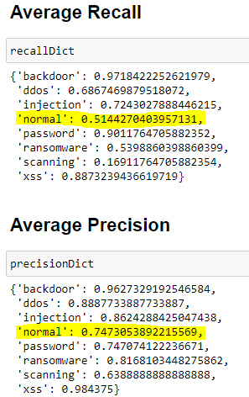
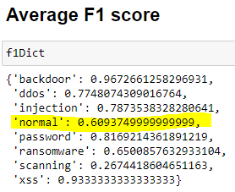
1D CNN model
Train accuracy : 88,84 % | Test accuracy: 87,8 %

